Slide 1
WSC Quant
Basics

Slide 2
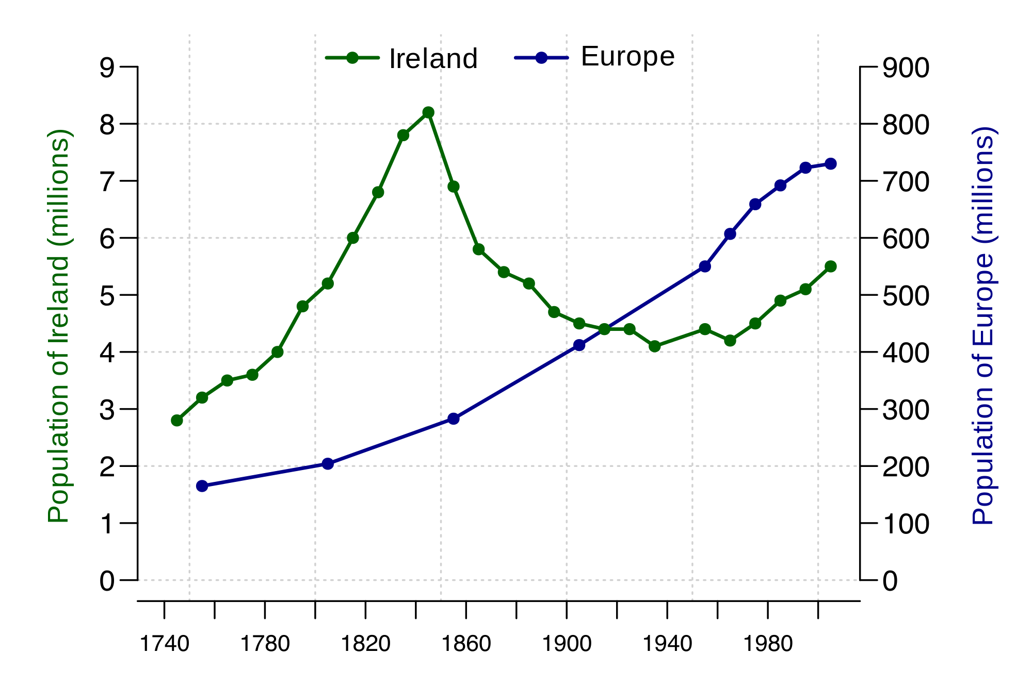
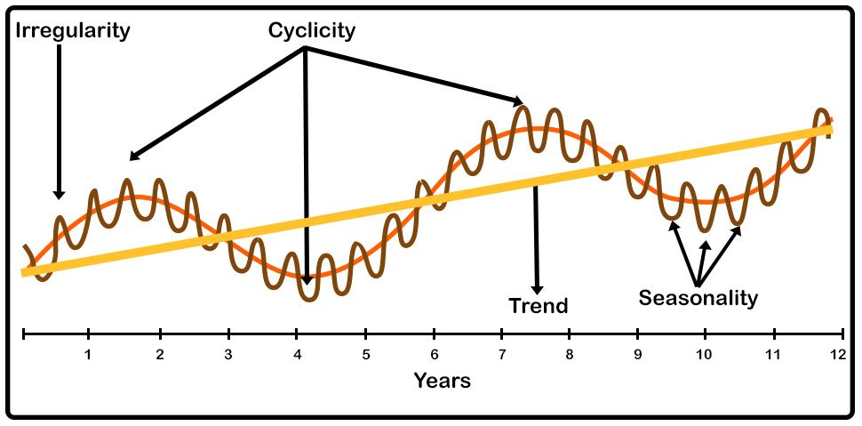
What is a time series?
In mathematics, a time series is a series of data points indexed in time order. Most commonly, a time series is a sequence taken at successive equally spaced points in time.

Slide 3
Understanding returns and their superiority over prices:
Why do we use returns instead of prices?
A good way of normalizing the dataset.
For average investors, return of an asset is a complete and scale-free summary of the investment opportunity. Second, return series are easier to handle than price series because the former have more attractive statistical properties.

Slide 4

What is CAGR? (ULIPs not the best investment?)
Compounded Annual Growth Rate:
CAGR lets you know the compounded returns you earn on an annual basis irrespective of the individual yearly performances of the fund.

Slide 5
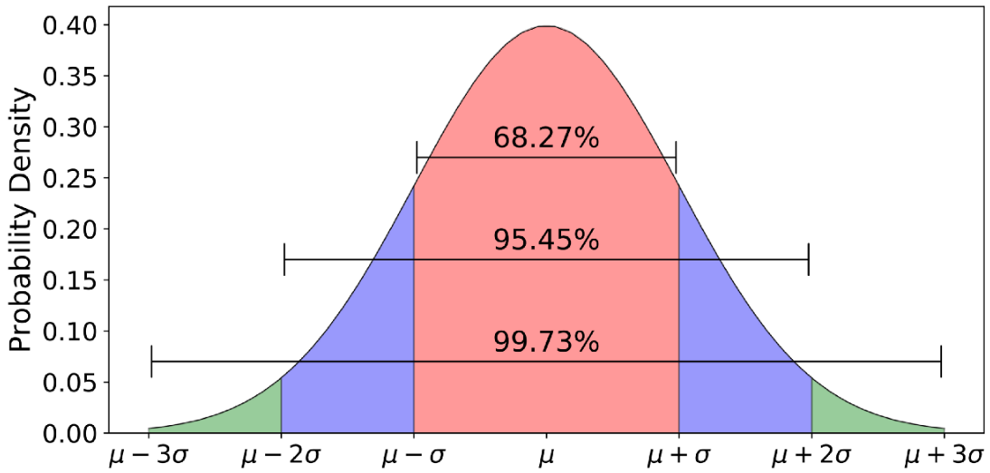
Normal distribution:
The normal distribution is the probability distribution that plots all of its values in a symmetrical fashion with most of the results situated around the probability's mean.

Slide 6
Resources:
Python:

